Slide 1
WEEKLY PROGRESS · WEEK 3
Building the UF3 model
Marios Poulis
Monday 21 September 2026
Notes:
So this week was about building my own model. Last week I'd validated the SuperSalt reproduction; this week I actually built the UF3 model from scratch — the 2-body version fully, and I started testing the 3-body term. Let me walk you through it.

Slide 2
AGENDA
This week
01
What UF3 actually is
The many-body expansion, flexible splines, a linear fit
02
The 2-body term and 3-body term
A learned pair potential — what it captures and what it can't
03
The pipeline I built
Five steps from structures to a working ASE calculator
04
Results & next steps
2-body accuracy on both test sets, and where it goes
Marios Poulis · DIFFER
2
Notes:
Quick roadmap: first what UF3 actually is under the hood, then the two-body and three-body terms, then the pipeline I built to train it, and finally the results and where I want to go next.

Slide 3
THE METHOD
What UF3 is
A force field written as a sum of simple interaction terms, each a flexible curve fit to DFT data.
E ≈ Σ E₁ + ½ Σ V₂(r) + ⅙ Σ V₃(triangle)
one-body offsets + pairs (built this week) + triangles (a later extension)
Flexible curves
A linear fit
“Ultra-fast”
Each term is a cubic B-spline — a smooth curve made of local bumps — not a fixed formula. It bends to fit whatever the DFT data shows.
Energy is linear in the spline coefficients, so training is one regularized least-squares solve — no iterative neural-network training.
That linear form is the whole point: fitting is seconds, and evaluating the potential in MD is far cheaper than a neural network.
Marios Poulis · DIFFER
3
Notes:
The core idea: instead of a big neural network, UF3 writes the energy as a sum of simple pieces — a one-body offset per element, a two-body term for every pair, and in principle a three-body term for triangles. Each piece is a flexible spline curve fit to the DFT data. And because the energy is linear in those spline coefficients, training isn't iterative — it's a single least-squares solve. That's the whole selling point: seconds to fit, cheap to run, and every curve is interpretable.

Slide 4
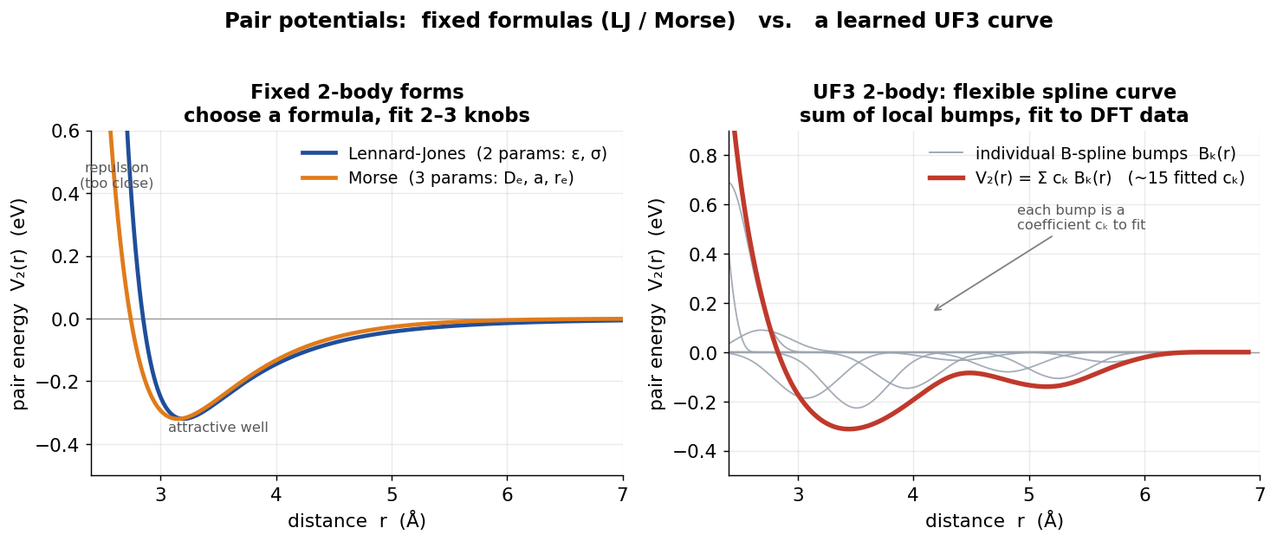
THE BUILDING BLOCK
The 2-body term: a learned pair potential
Reading the curve V₂(r)
Repulsive wall — how close two atoms can get (their size).
Minimum position — the preferred bond length.
Well depth — how strong the bond is.
Curvature — the stiffness of the bond.
Left: fixed formulas (Lennard-Jones, Morse) have 2–3 knobs. Right: UF3's pair term is a spline — ~15 coefficients — so it can take a shape the fixed forms can't.
It depends only on distance — so it captures how far, never at what angle.
Marios Poulis · DIFFER
4
Notes:
The building block is the two-body term — a pair potential, energy as a function of the distance between two atoms. On the left are the classic fixed formulas, Lennard-Jones and Morse, with two or three knobs. UF3 replaces the formula with a flexible spline — about fifteen coefficients — so it can take any shape the data needs. You read the curve directly: the wall is atom size, the dip is bond length, its depth is bond strength. But — and this is the key limitation for later — it depends only on distance. It sees how far, never at what angle.

Slide 5
FROM STRUCTURES TO A CALCULATOR
The pipeline
1
Define the system
List the 12 elements; ask for the 2-body pairs
the fit — one solve, not a training loop
cs = ChemicalSystem(elements, degree=2)
basis = BSplineBasis(cs, r_min, r_max, res)
X = featurize(frames)
model = WeightedLinearModel(basis, reg)
model.fit(x_e, y_e, x_f, y_f, weight=0.3)
calc = UFCalculator(model)
2
Build the basis
A B-spline per pair over r = 1.0–6.0 Å → 1,416 coefficients
3
Featurize
Turn every structure + force into rows of spline values
4
Fit
One regularized least-squares solve for all coefficients
5
Wrap as a calculator
Same ASE-calculator interface as MACE — so the exact evaluation loop from the reproduction scores UF3 with no changes.
A UF3 ASE calculator — drop-in, like the MACE one
Marios Poulis · DIFFER
5
Notes:
The pipeline is five steps: define the system and get the pairs; build a spline basis — that's 1,416 coefficients for the twelve elements; featurize every structure and force into rows of numbers; fit all the coefficients in one regularized least-squares solve; and wrap the result as an ASE calculator. That last part matters — it's the same interface as MACE, so the exact scoring loop from last week's reproduction works on my model with no changes.

Slide 6
RESULTS
First working model: the 2-body numbers
Trained on a representative sample of the SuperSalt training set; scored on a fixed 660 / 160-frame slice of each held-out test set.
ENERGY MAE · BOTH TESTS
13–15 meV/atom
the surface itself is roughly right
FORCE RMSE · BOTH TESTS
278–302 meV/Å
the slope — where a pair term is limited
STATUS
It runs, end-to-end
my own model, real numbers, both sets
Marios Poulis · DIFFER
6
Notes:
Here's the first working model, scored on both held-out test sets with the same metric as the paper. Energies are reasonable — 13 to 15 meV per atom. Forces are 278 to 302, well above MACE's roughly 20. I want to be clear why: that gap is structural, not a data problem — I ran a learning curve, and more data doesn't lower it. A pair potential fundamentally can't represent angular forces, so it hits a floor. The point isn't to beat MACE on accuracy — it's that it trains in seconds, runs about a thousand times cheaper, and it's the foundation the three-body term improves on. ACTING ON YOUR CRITIQUE: one thing worth flagging — I benchmarked against the SWA model, not the plain SuperSalt one. That came directly from your report: you'd found from the authors that the SWA checkpoint was the one used for all their benchmarking, so it's the fair baseline. I also confirmed which test file is which by composition, not by the filenames, since you flagged the naming as ambiguous — and I hit the same swap you did. And where my Test-1 number doesn't perfectly match the paper, I'm reading that as the reproducibility ambiguity you documented — the model-per-figure being unstated and the D3 handling unclear — rather than a bug on my side.

Slide 7
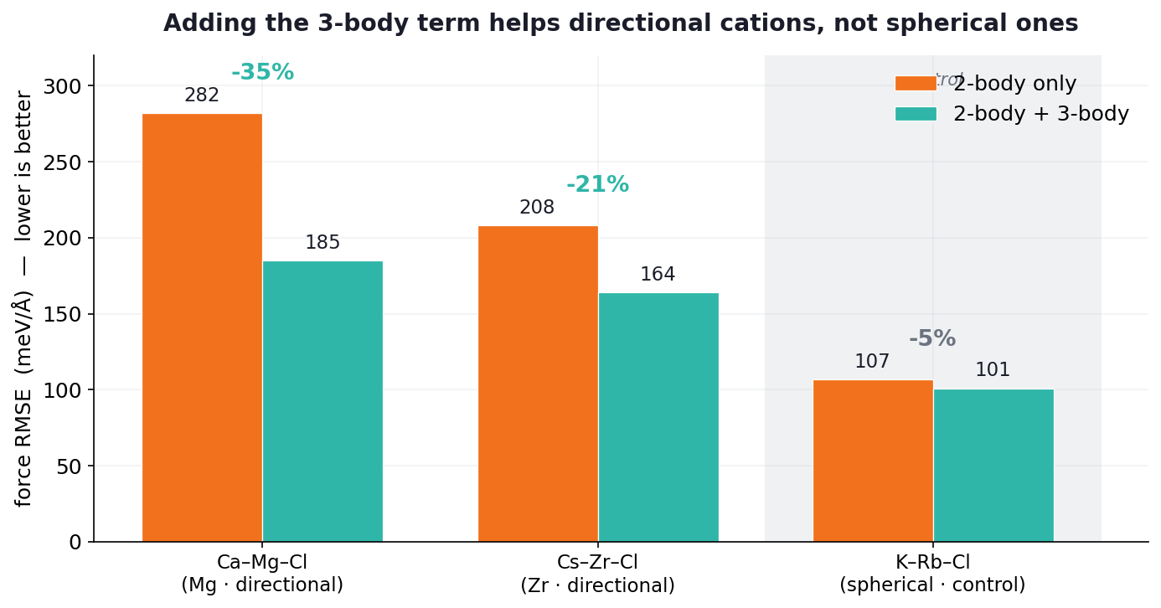
TESTING THE “3” IN UF3
Does the 3-body term earn its keep?
Full 3-body is intractable for 12 elements (111k features), so I test it on 3-element subsystems: directional cations (Mg, Zr) versus a spherical control (K, Rb).
What it shows
Directional cations. 3-body cuts the force error hard — Mg −35%, Zr −21%. The angular term captures the coordination geometry a pair potential can’t see.
Spherical control. K/Rb already had a low 2-body error and 3-body barely moves it (−5%) — round ions bond centrally, so there’s little angle to capture.
The gain tracks directionality — exactly where the physics predicts.
Marios Poulis · DIFFER
7
Notes:
This is the part I'm most happy with. Full 3-body over twelve elements is intractable — 111 thousand features — so I tested it on small three-element subsystems, and I designed it as a controlled experiment: two systems with directional cations, magnesium and zirconium, where angles should matter, and one spherical control, potassium-rubidium, where they shouldn't. The result is clean: three-body cuts the force error 35 percent for magnesium, 21 for zirconium, but only 5 percent for the spherical control. So the improvement tracks directionality exactly, which tells me it's genuinely capturing angular coordination, not just adding parameters. These are small subsystems with a short cutoff, so I treat the absolute numbers as a proof of concept — but the directional-versus-control contrast is the robust claim.

Slide 8
ROADMAP
Next steps
Firm up the 3-body subsystem result
Larger frame counts and a longer cutoff to confirm the 20–35% force gains on directional cations; add a third (Zn). Featurization is slow, so this runs off the laptop.
NOW
Score on the full test sets
Move from sampled to complete Test 1 / Test 2 evaluation, using the fast matrix-multiply scoring, for paper-comparable numbers.
NEXT
Request compute access
Ask Daniel for a DIFFER cluster / workstation — UF3 featurization is single-threaded and heavy, so scaling to more data and a fuller cutoff needs more CPU (not GPU).
ASK DANIEL
Marios Poulis · DIFFER
8
Notes:
Next: I want to firm up those three-body numbers with more data and a longer cutoff — but the featurization is single-threaded and heavy, so it's slow on my laptop. Which is my one ask: is there a DIFFER cluster or workstation I could use? It's CPU I need, not GPU — UF3 has no GPU path. After that, score on the full test sets for final numbers. And for the MD phase later, I've noted the points from your critique on initialization and finite-size effects — packing and equilibrating the start structures, and using big-enough boxes. That's where I'm at — anything you'd change or want me to prioritise?

